Slide 1
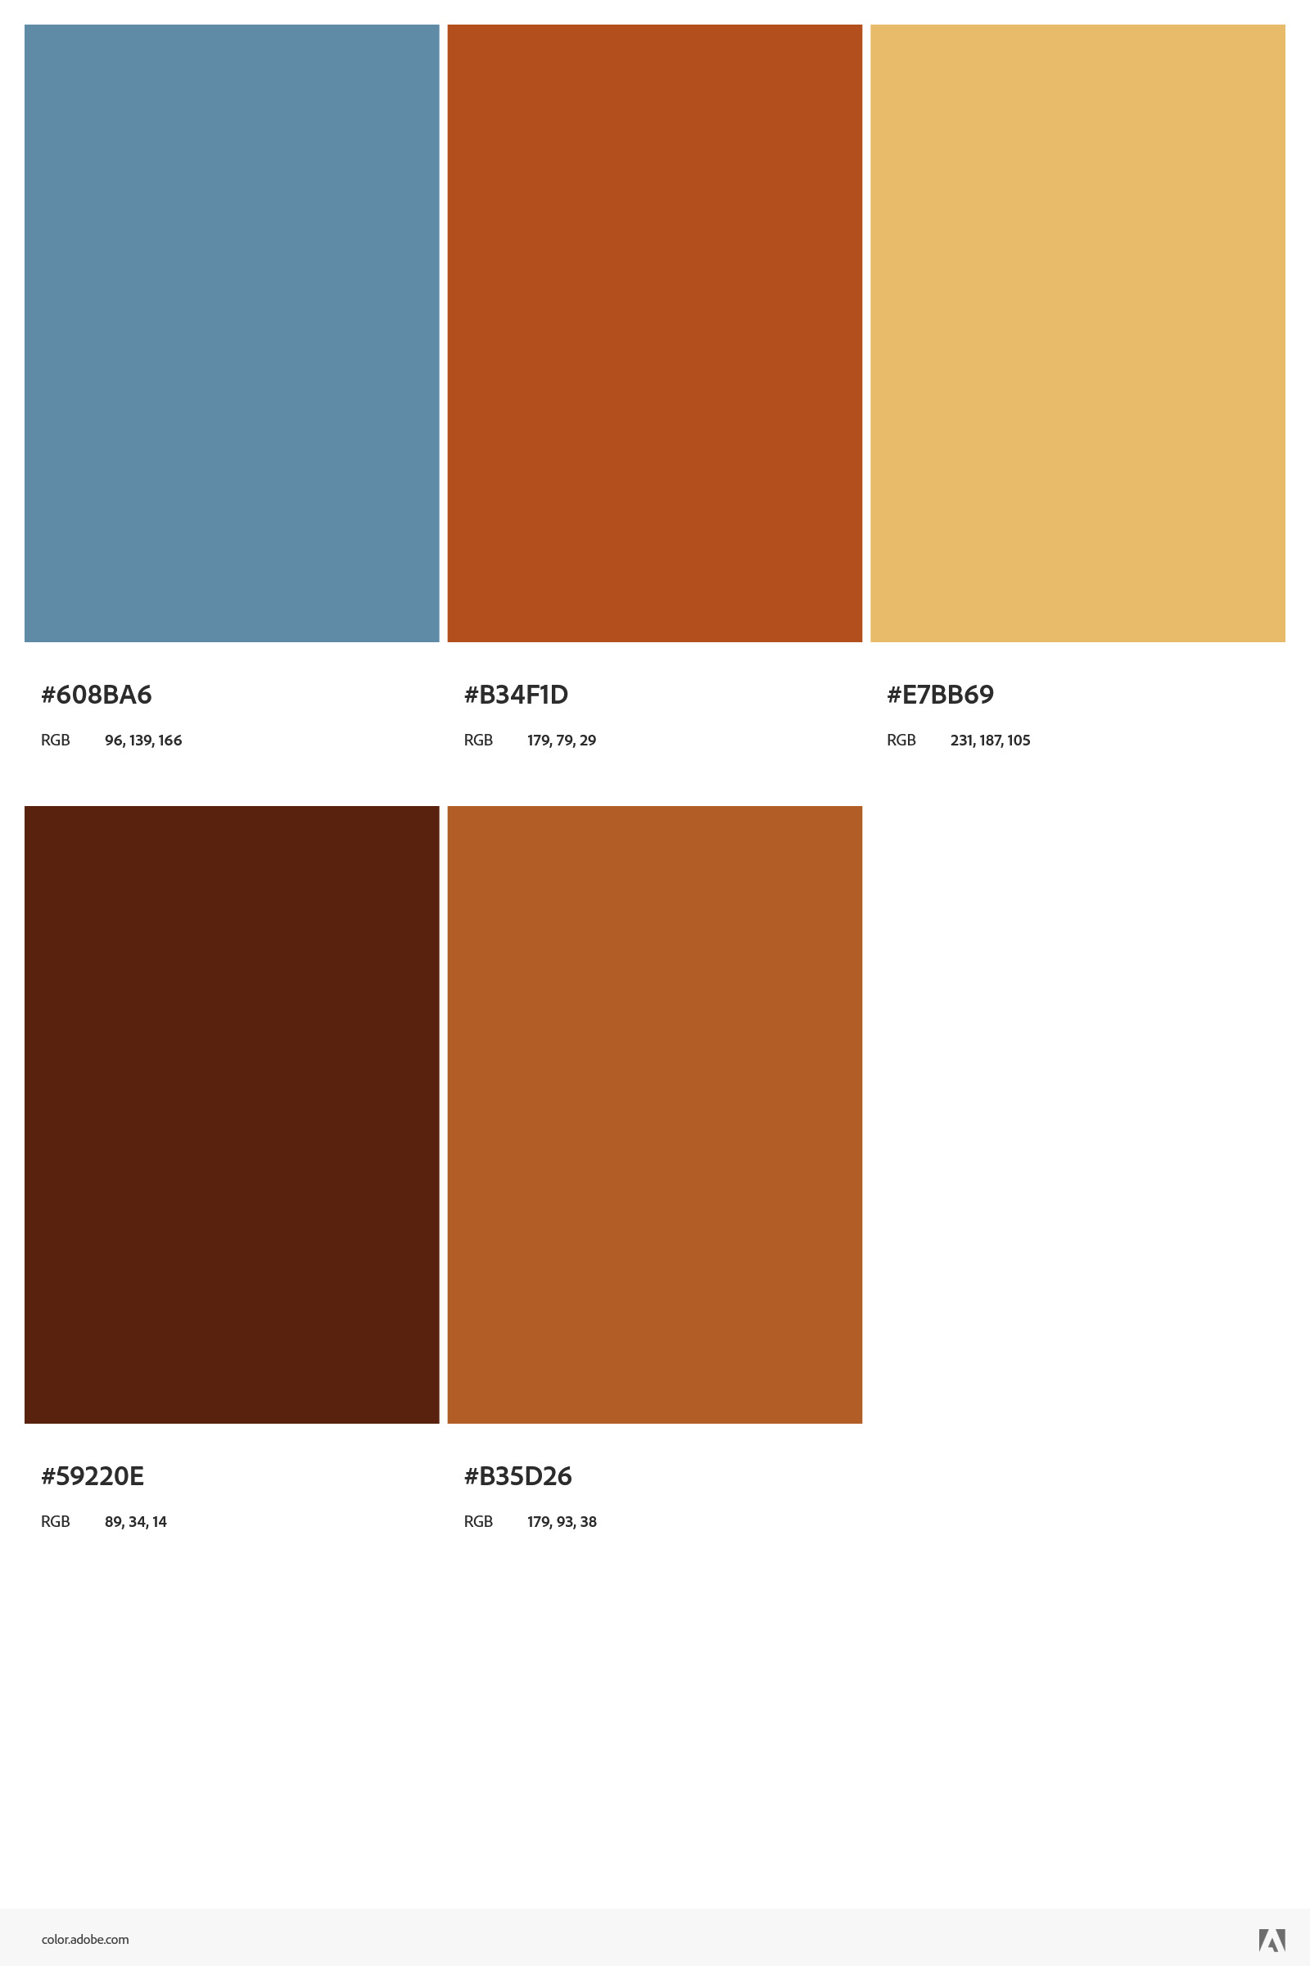


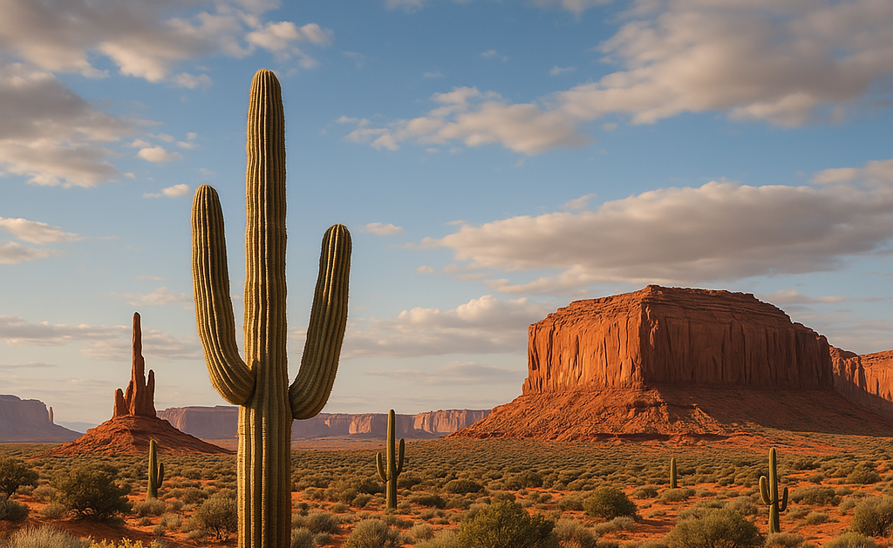
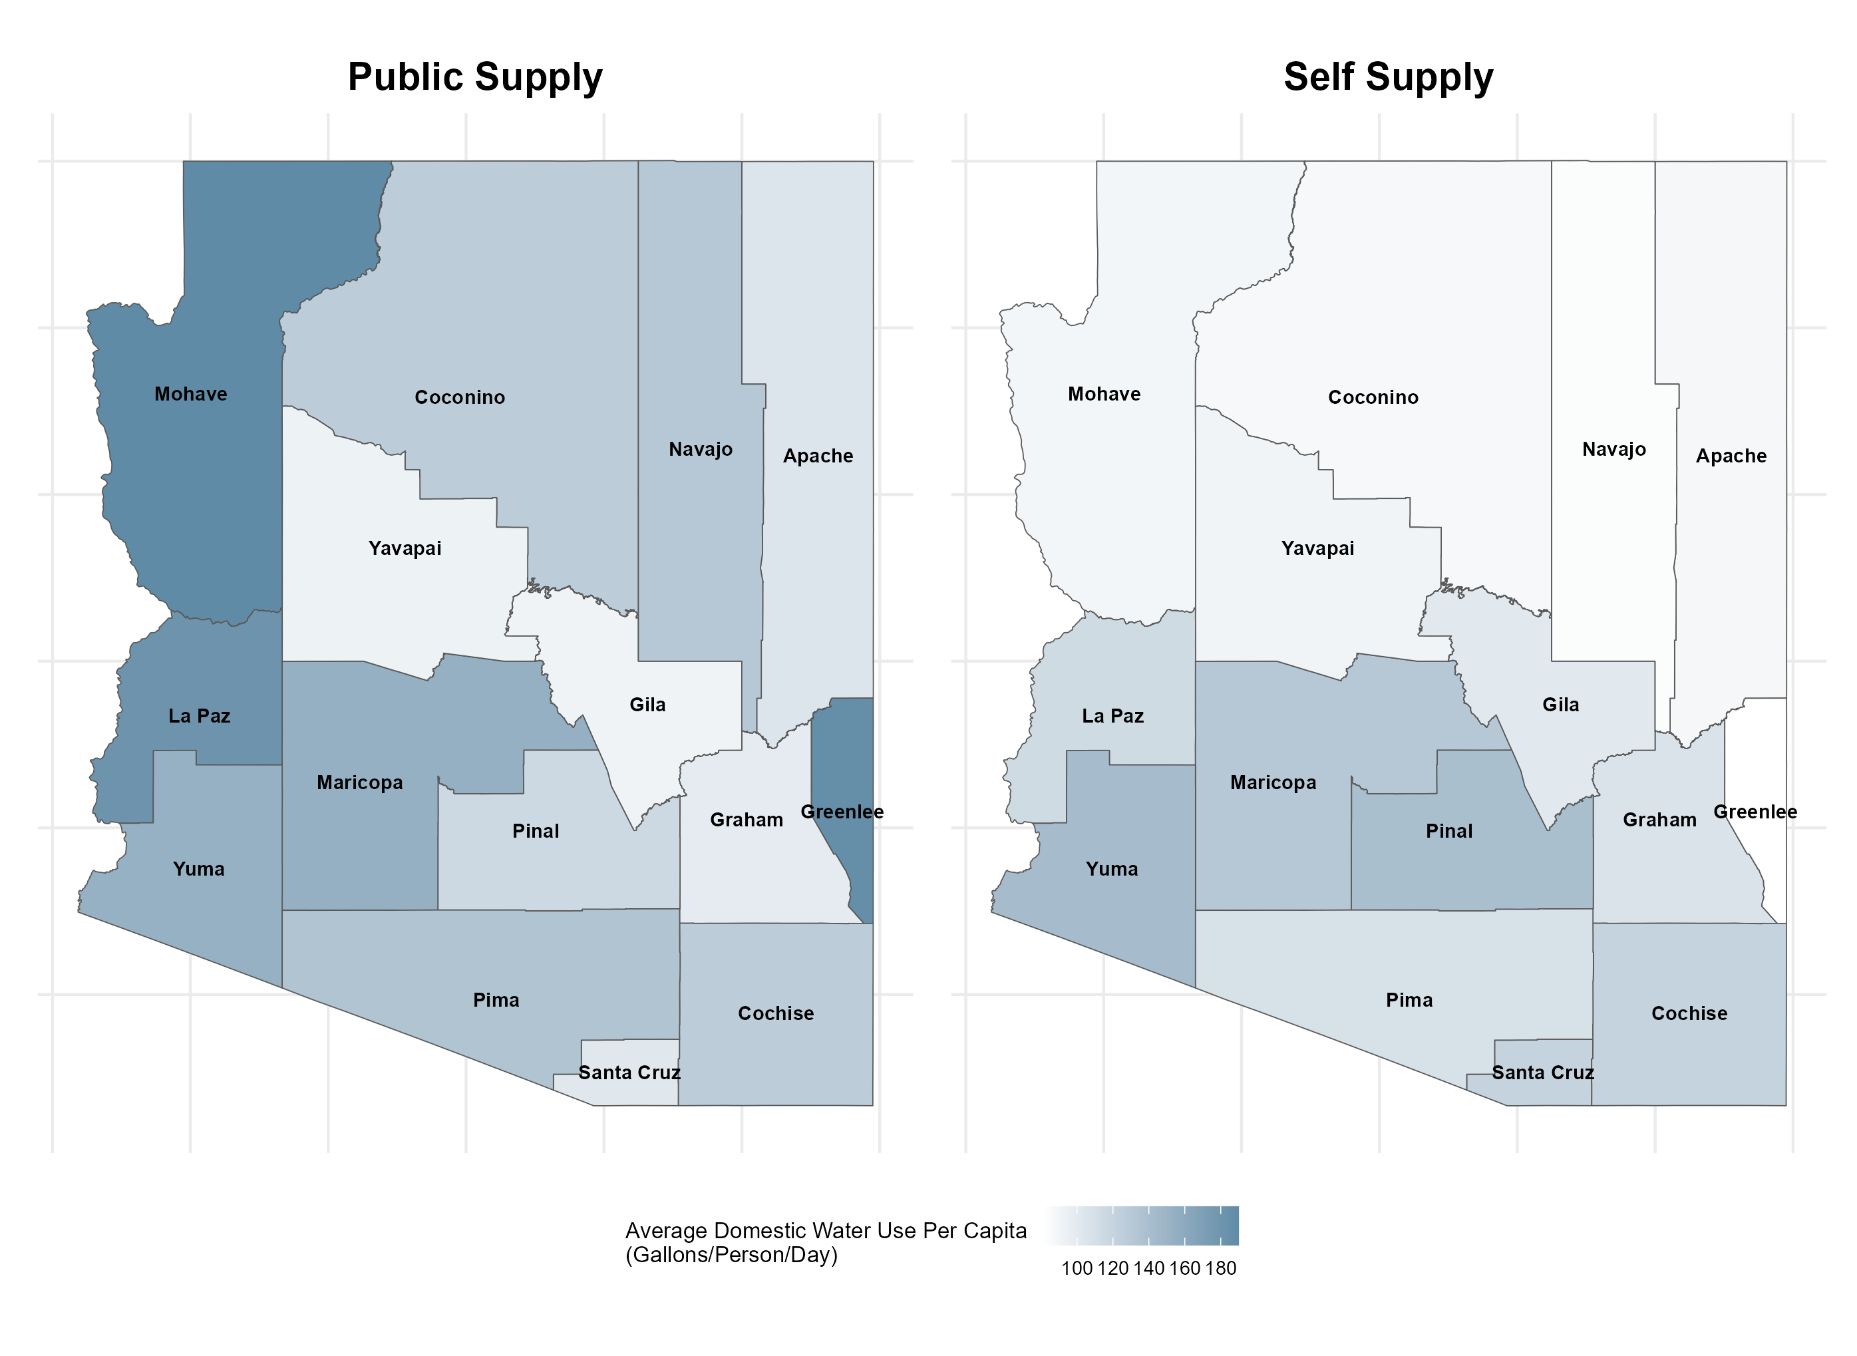
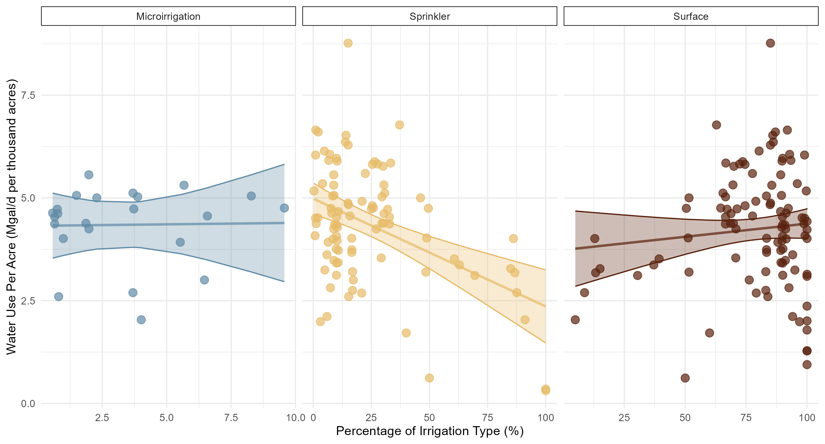
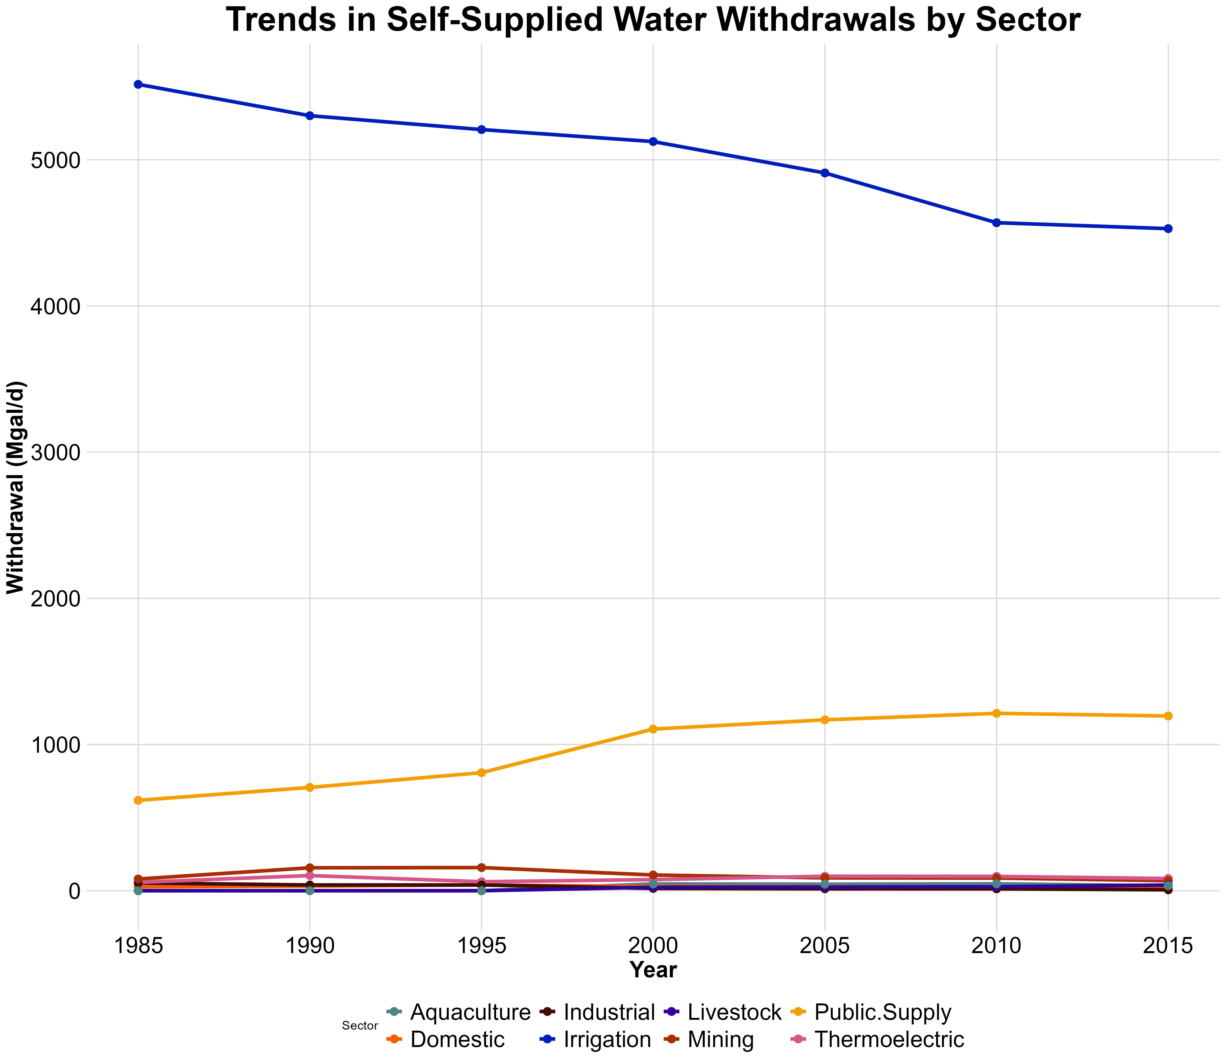
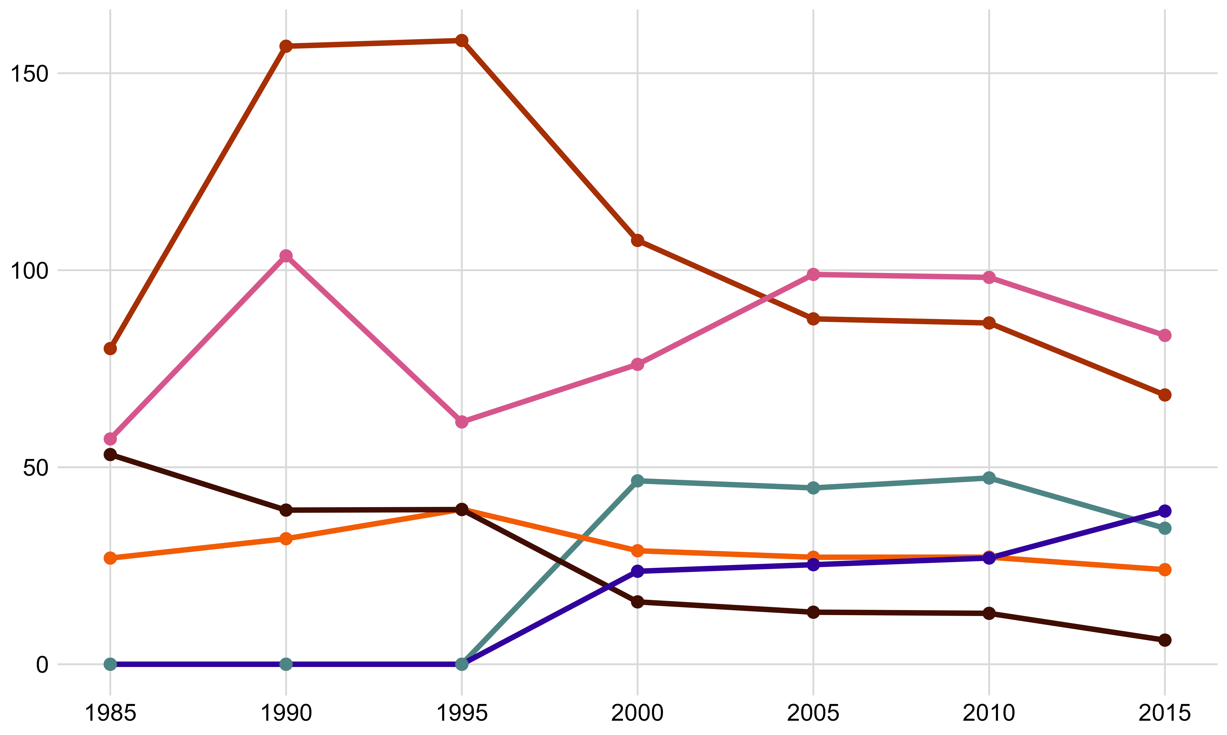

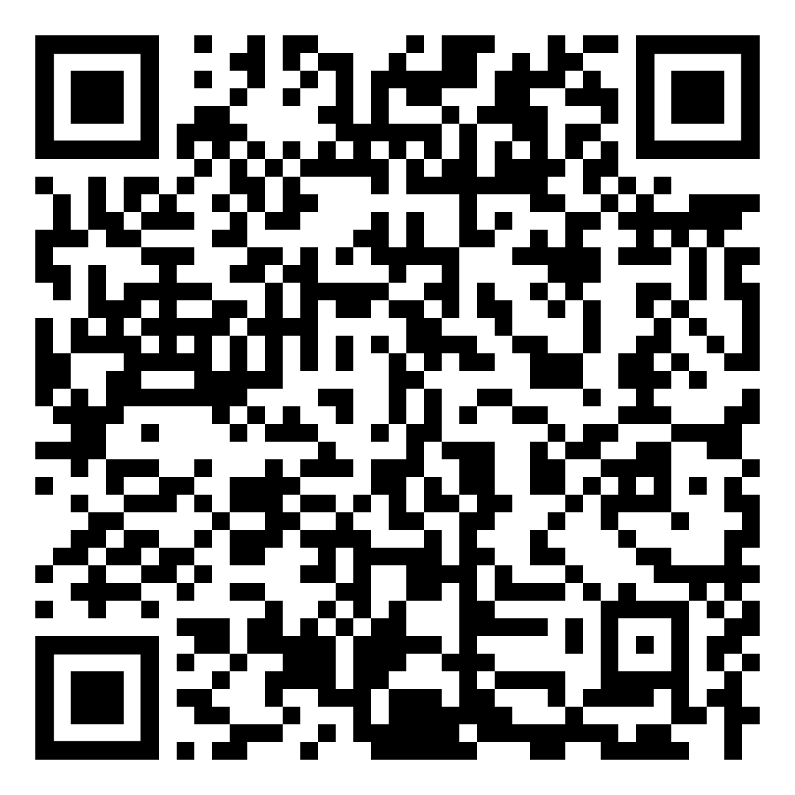
Arizona Water: A Frame work for resource optimization
Jack Tomlon, Delila Medlin
The Department of Mathematics and Statistics, Northern Arizona University, Flagstaff, AZ 86011
Abstract
Analysis
The plots to the right are the combined Domestic Water use per capita per person
There is a large discrepancy between Domestic use from Public vs. Self-Supplied water.
“Public Supply” is the per-capita-per-person water use of the publicly supplied water in domestic sector, which includes all water used for indoor and outdoor household purposes. This includes drinking, cooking, bathing, laundry, dishwashing, flushing toilets, watering lawns and gardens, and maintaining pools.
A positive slope indicates low water use efficiency. A negative slope indicates high efficiency.
There is limited data on Microirrigation, so this relationship may not be properly reflected in this set.
As of March 2025, a staggering 99% of Arizona was in a state of drought (US Drought Monitor 2025).
Decreases in precipitation in our state have brought about concerns for the future of Arizona’s water future, and how the state is going to sustain our growing population and water consumption rates.
This project analyzes water production and consumption data from the United States Geological Survey (USGS) to identify anomalies and investigate sectors exhibiting unusual water loss in Arizona. The data, collected from publicly available USGS resources includes information on water withdrawals, usage by sector, and sources such as surface and groundwater. The goal is to uncover patterns and discrepancies that may indicate inefficiencies or areas for improved water management. Additionally, this analysis explores the potential ethical and environmental benefits of increasing the use of reclaimed water within Arizona’s water management strategy.
By identifying opportunities to optimize water use and integrate sustainable practices, the project aims to support more informed decision-making for managing Arizona’s limited water resources sustainably.
What does that mean?
Arizona withdrawals are defined as water removed from a ground- or surface-water source for use.
The vast majority of water in the state is used for Irrigation, then through Public Supply withdrawals.
Irrigation and Public sector withdrawal the most water for Arizona.
The Public withdrawal also get sent to other sectors for use.
The blown-up figure shows sectors Domestic, Thermoelectric, Industrial, Mining, Livestock, and Aquaculture
The Problem
Discussion
Arizona is facing a critical water crisis due to a combination of prolonged drought, climate change, and overuse of water resources.
The Colorado River runoff has declined sharply, dropping reservoir levels in Lake Mead and Lake Powell to historic lows. (USGS)
The combined reservoirs storage lost 33.5 million acre-feet in the past 20 years, leaving only 15 months of average consumption reserves. (USGS)
Addressing these challenges requires substantial reductions in water use and the implementation of sustainable management practices to stabilize and recover water storage levels.
Arizona's water primarily goes to Industrial Agriculture Irrigation, with inefficient Surface Irrigation dominating, despite more efficient alternatives like Sprinkler and Microirrigation systems. While Agriculture remains vital to Arizona's economy, Irrigation efficiency can be improved. With Arizona being in the southwest desert our water management and public use it vitally important as our population increases. The community of Arizona needs to educate themselves and support proper legislation that help keep water in our homes and on our farms for future generations.
One way AZ is trying to improve this through 42 USC 10364: Water Management Improvement Bill. This bill authorizes the Secretary (presumably of the Interior Department) to provide grants to improve water management. Though there are some drawbacks with the bill.
Limited Tribal Considerations
Ceiling on how much funding can be received
Ambiguous language on which projects are prioritized
Looking forward we need to encourage policy makers to address these issues.
Looking into the Irrigation sector they have 3 distinct methods or irrigating water.
The proportion of Surface watering has slowly decreased since 1985.
Conversely, the proportion of Sprinkler and Micro-irrigation watering has increased slightly.
Proportion of Irrigation method in Arizona
Year | Sprinkler | Micro-irrigation | Surface
1985 | 19.92% | 0.00% | 80.08%
1990 | 20.65% | 0.00% | 79.35%
1995 | 18.54% | 1.32% | 80.13%
2000 | 21.15% | 1.39% | 77.46%
2005 | 24.75% | 2.15% | 73.10%
2010 | 19.64% | 2.83% | 77.53%
2015 | 24.21% | 5.53% | 70.27%
Key Questions
What patterns or anomalies in water consumption can we identify across USGS sectors in Arizona?
Which sectors have a high potential for growth in efficient water use
How can we inform policy decisions aimed at optimizing water resources and mitigating the impacts of water scarcity
References & Acknowledgements
Dr. Robert Buscaglia
USC 10364
USGS Sources

